Slide 1
A/B Testing Mekargo.id Website of Mekar PT Sampoerna
Wirausaha with Bayesian Inference and Pymc3
ALVIAN DWI KURNIANTO
92216007
BUSINESS INFORMATION SYSTEM
SUPERVISOR: DR. Setia Wirawan

Slide 2
OUTLINE
INTRODUCTION
Background
Problem Identification
Scope of Problem
Research Purposes
Research Benefits
CONCLUTION AND SUGGESTION
Conclusion
Suggestion
RESULT AND DISCUSSION
Identifying Problems
Defining Website Measurement
Developing Hypothesis
Developing & Testing Page Variation
Analyzing Test Results

Slide 3
INTRODUCTION
BACKGROUND
Small Medium Enterprise (SMEs) has an important role in encouraging the growth of the Indonesian economy.
Currently, SMEs have been the mainagenda of Indonesia’s economic development
The most prominent issue of SMEs involves providing business financing or business capital
However, to partner with banks, small businesses are required to present business proposals that are feasible or feasible and profitable
Mekar provides solutions to SMEs and other Consumers to get Financial Services Access or Capital in Indonesia.
Notes:
Testing:
- One of a good test is a test that has a high probability of finding
errors. flow
Software testing also aims to gain trust from users.
In the system development flow, testing is done after the coding process, but testing is not only seen as the last step of the system development. Testing has its own flow.
The creation of template of test plans, test cases, and test procedures is based on the format contained in IEEEStandard-829-2008 to facilitate effective testing. IEEE-Standard-829-2008 is a standard for software and system testing documentation.

Slide 4
INTRODUCTION
PROBLEM IDENTIFICATION
The problem discussed in this research is to determine which version of
mekargo.id website at PT Mekar Sampoerna Wirausaha with A / B testing
which become the best version with bayesian inference method with pymc3
tools.

Slide 5
INTRODUCTION
SCOPE OF PROBLEM
1. The object of research is the website mekargo.id.
2. The research was conducted at PT Mekar Sampoerna Wirausaha.
3. Study time between August 2017 to January 2018.
4. Data collection method for A / B testing techniques on mekargo.id website with the help of Google Analytics tools.
5. The generated data from A / B testing is analyzed by Bayesian inference analysis using pymc3, numpy, matplotlib, scipy, jupyter and Ipython tools with python programming language.
6. Mekargo.id website features that studied is a feature of input data by borrower.
7. Mekargo.id website feature that is not discussed is a static page feature that contains the home page, about us, terms and conditions, privacy policy and contact us.
Notes:
Automated testing tools:
Selenium: provides a rich set of testing functions specifically geared to the needs of testing of a web application.
Selenium provides domain-specific testing languages (Selenese), for writing tests in a number of popular programming languages, including C#, Groovy, Java, Perl, PHP, Python, Ruby, and Scala.
Testing can run on any web browser and can be done on Windows, Linux, and OS X platforms.

Slide 6
INTRODUCTION
RESEARCH PURPOSES
The purpose of this research is to know the version of A / B testing
which is the best version of mekargo.id website at PT Mekar Sampoerna
Entrepreneurship with bayesian inference method with pymc3.
Notes:
Automated testing tools:
Selenium: provides a rich set of testing functions specifically geared to the needs of testing of a web application.
Selenium provides domain-specific testing languages (Selenese), for writing tests in a number of popular programming languages, including C#, Groovy, Java, Perl, PHP, Python, Ruby, and Scala.
Testing can run on any web browser and can be done on Windows, Linux, and OS X platforms.

Slide 7
INTRODUCTION
RESEARCH BENEFITS
The benefits of this research are:
1. For the researcher, be a guide or research reference in the field of information system in A / B testing with bayessian inference method.
2. For other researchers, as a literature source for A / B testing withbayessian inference method.
3. For the company under study, provide an alternative to solving the problem of choosing the best version with A / B testing.
Notes:
Automated testing tools:
Selenium: provides a rich set of testing functions specifically geared to the needs of testing of a web application.
Selenium provides domain-specific testing languages (Selenese), for writing tests in a number of popular programming languages, including C#, Groovy, Java, Perl, PHP, Python, Ruby, and Scala.
Testing can run on any web browser and can be done on Windows, Linux, and OS X platforms.

Slide 8
RESULT & DISCUSSION
IDENTIFYING PROBLEMS
PT Mekar or Sampoerna Wirausaha is a fintech company running a busi
ness with a peer-to-peer loan platform. Mekar Go is a website used to collect
borrower data. The data collected on the current version of Mekar Go web-
site shows the conversion of a borrower who completes data filling from start
to finish less than 10%. This conversion percentage by the marketing team
is too small and needs to be improved.

Slide 9
RESULT & DISCUSSION
DEFINING WEB MEASUREMENT
1. Business Objective
The desired business objective is to increase the number of borrowers that will be given a peer-to-peer lending loan.
2. Website Goal
Increase the number of borrowers who register, increase the percentage completion of filling the registration form by the borrower.
3. Key Performance Metric
The number of registrants per month and the percentage completion of form filling by the borrower upon filling in the registration form
4. Target Metric
The expected target is 500 unique visitors who register for each version and percentage of data completion above 10% for each version

Slide 10
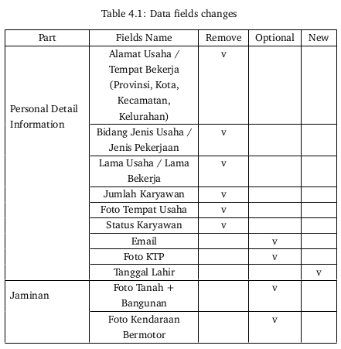
RESULT AND DISCUSSION
DEVELOPING & TEST PAGE VARIANTS
Developing Page Variants

Slide 11
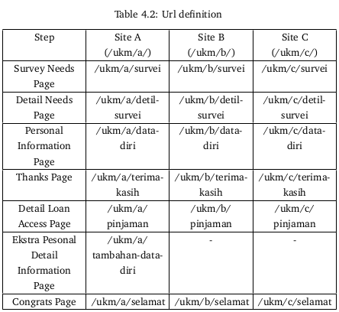
RESULT AND DISCUSSION
DEVELOPING & TEST PAGE VARIANTS
Developing Page Variants

Slide 12
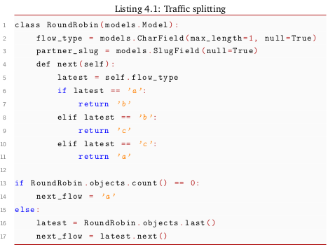
RESULT AND DISCUSSION
DEVELOPING & TEST PAGE VARIANTS
Developing Page Variants

Slide 13
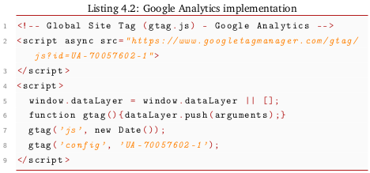
RESULT AND DISCUSSION
DEVELOPING & TEST PAGE VARIANTS
Testing Page Variants

Slide 14
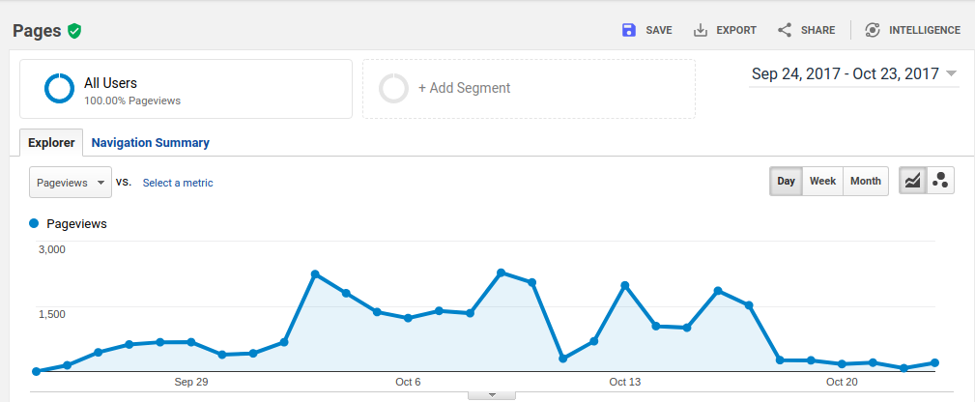
RESULT AND DISCUSSION
DEVELOPING & TEST PAGE VARIANTS
Testing Page Variants

Slide 15
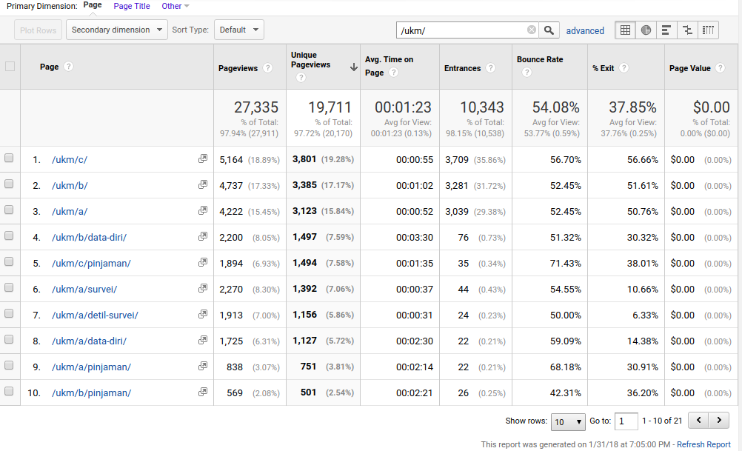
RESULT AND DISCUSSION
DEVELOPING & TEST PAGE VARIANTS
Testing Page Variants

Slide 16
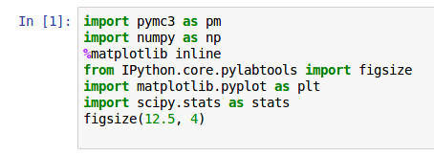
RESULT AND DISCUSSION
Analyzing Test Results

Slide 17
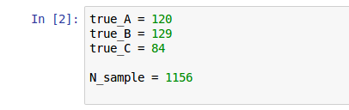
RESULT AND DISCUSSION
Analyzing Test Results

Slide 18
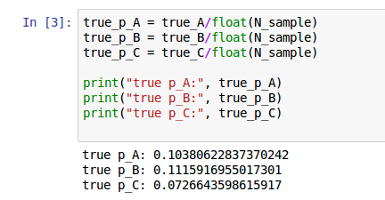
RESULT AND DISCUSSION
Analyzing Test Results

Slide 19
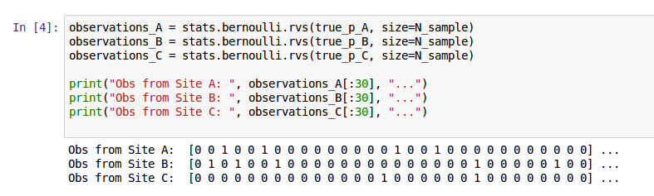
RESULT AND DISCUSSION
Analyzing Test Results

Slide 20
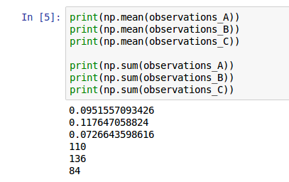
RESULT AND DISCUSSION
Analyzing Test Results

Slide 21
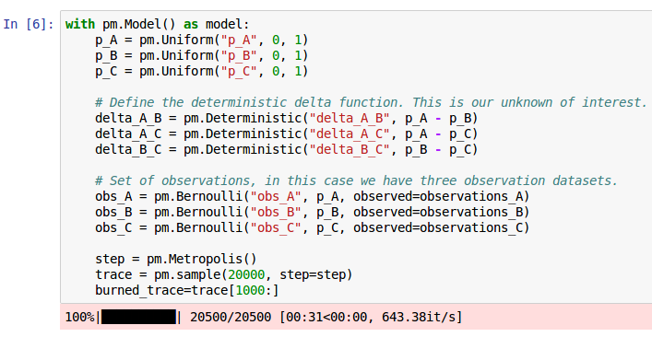
RESULT AND DISCUSSION
Analyzing Test Results

Slide 22
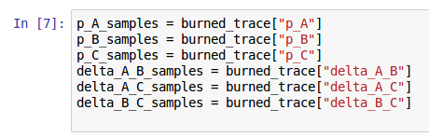
RESULT AND DISCUSSION
Analyzing Test Results

Slide 23
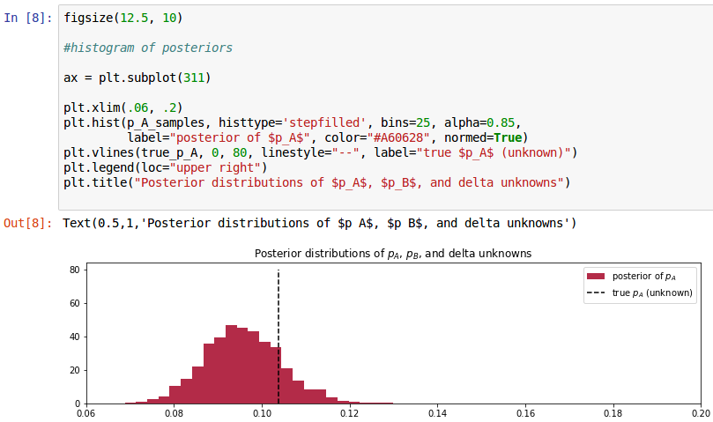
RESULT AND DISCUSSION
Analyzing Test Results

Slide 24
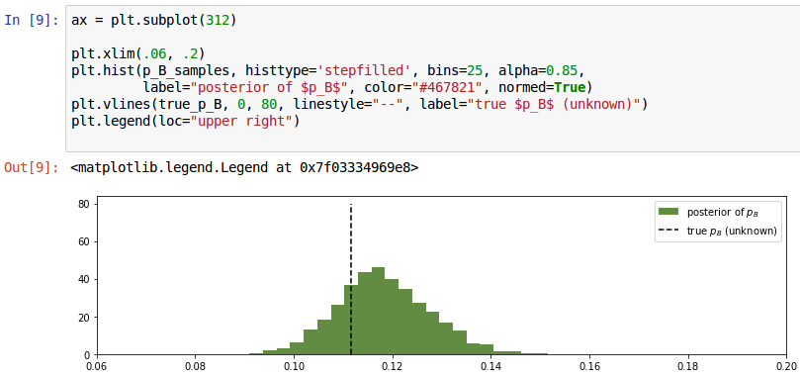
RESULT AND DISCUSSION
Analyzing Test Results

Slide 25
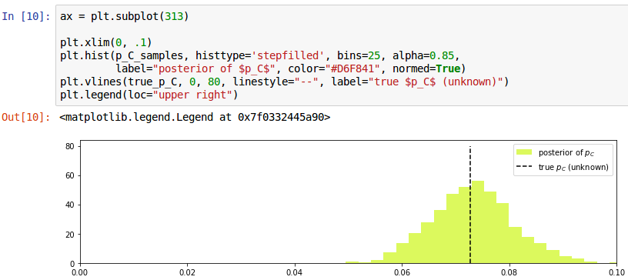
RESULT AND DISCUSSION
Analyzing Test Results

Slide 26
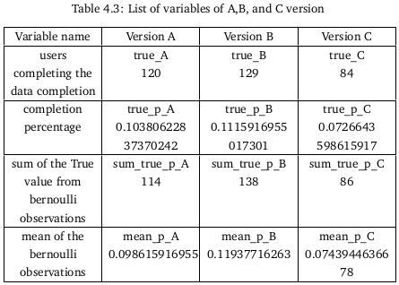
RESULT AND DISCUSSION
Analyzing Test Results

Slide 27
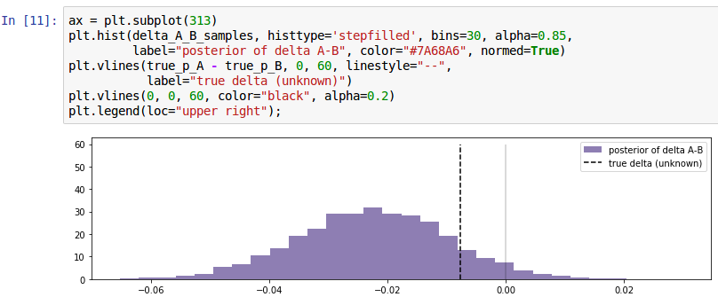
RESULT AND DISCUSSION
Analyzing Test Results

Slide 28
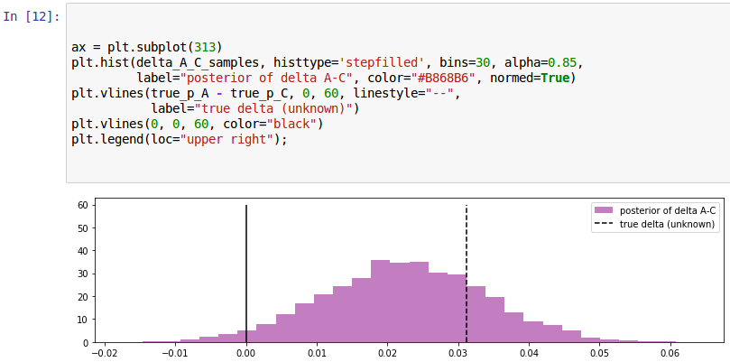
RESULT AND DISCUSSION
Analyzing Test Results

Slide 29
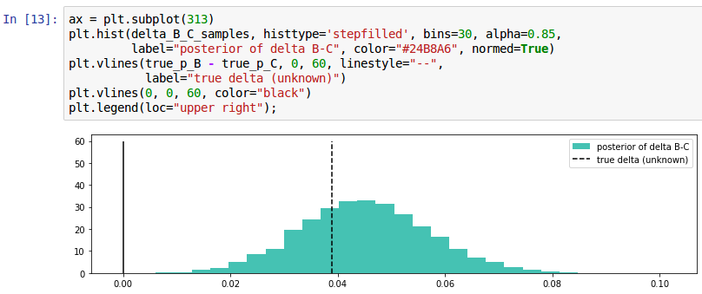
RESULT AND DISCUSSION
Analyzing Test Results

Slide 30
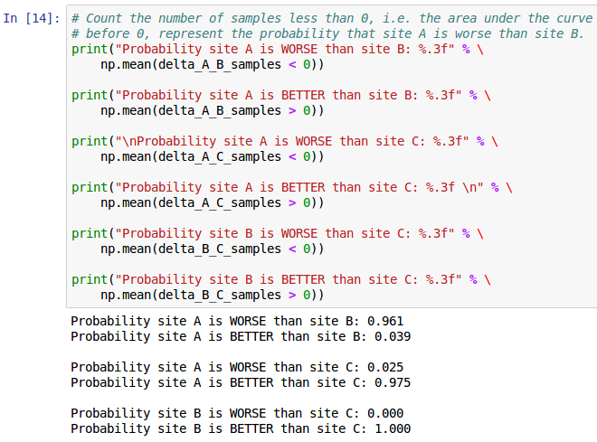
RESULT AND DISCUSSION
Analyzing Test Results

Slide 31
CONCLUSION & SUGGESTIONS
CONCLUSION
After performing A / B testing on the website mekargo.id it can be concluded that the final result of all combinations of probabilities generated by version B is the best result because it is always better when compared with versions A and C.

Slide 32
CONCLUSION REMARKS
SUGGESTION
Future research can be attempted to perform A / B testing with more
versions and use another method of bayesian inference method with multi-
arm bandit algorithm for more complex problem.

Slide 33
CONCLUSION REMARKS
Thank You

